Slide 1
Oncology Center Services and Prediction Techniques
to Assist in Making Right Decision.
Under Supervision of
Prof. Dr.Elsayed Badr

Slide 2
Team Members
Alaa Walid Mohamed Alshitany
Eman Tarek Taha Ali
Basma Talaat Mahmoud Mohamed
Abdelrahman Ahmed Abdelhady
Yara Ahmed Mohamed Swisa

Slide 3
Agenda
Introduction
Problems and Solutions
Analysis
Model
Previous work
Results
Future work
Summary

Slide 4
Introduction
- Difference between Oncology and cancer.
-The DNA inside a cell is grouped into many individual genes.
-Each gene contains a set of instructions that tell the cell what functions to perform and how to grow.
-Errors in these instructions can stop the cell from performing its normal function and may allow the cell to become cancerous.
-Cancer is characterized by the development of abnormal cells that divide uncontrollably.
- Cancer is a major cause of death worldwide and is the leading cause of death for 10 million people, or approximately one death in every 6 deaths.

Slide 5
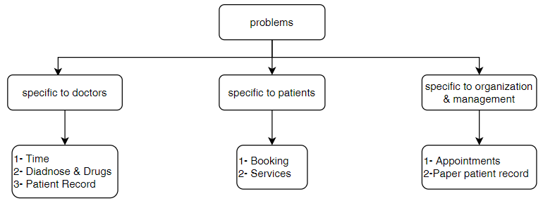
Problems
-Centers interested in diagnosing and treating tumors have a set of problems.

Slide 6
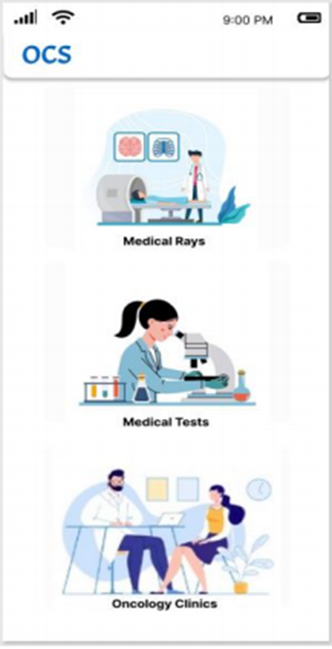
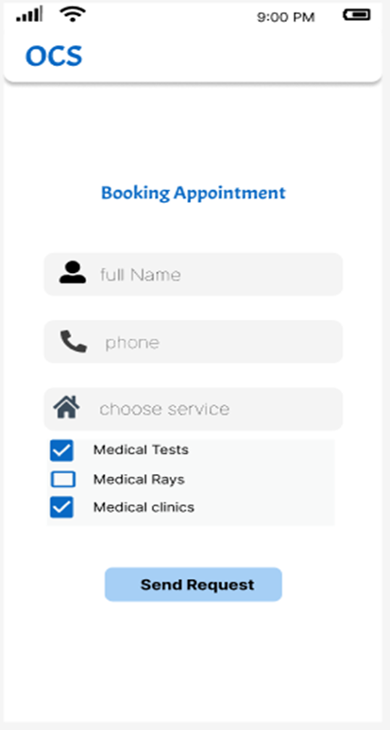
PROBLEM SOLUTION
we have provided some solutions to most of the problems,by making an application that provide some facilitate for both doctor and patient.
For patient:
Services
booking online

Slide 7
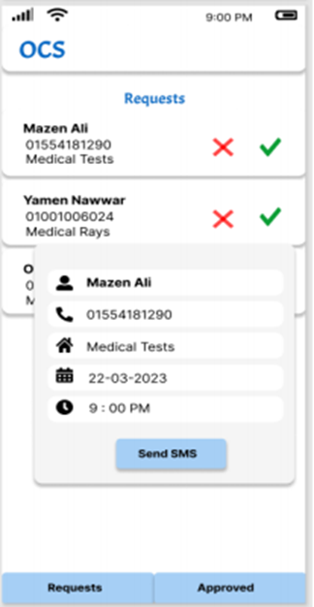
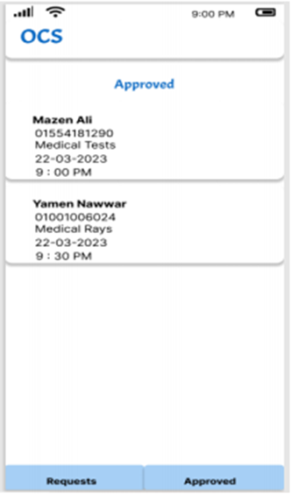
PROBLEM SOLUTION
For organization & management:
Appointments
Requests

Slide 8
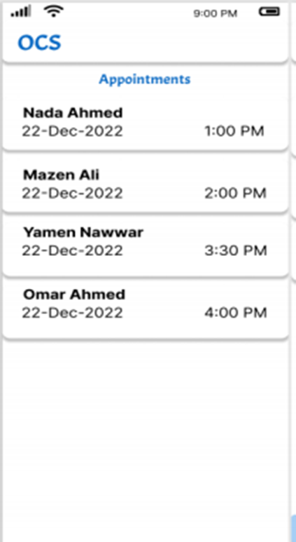
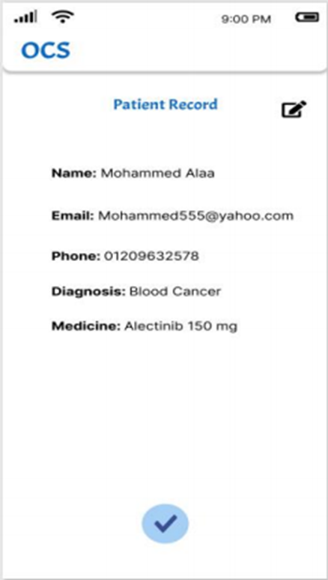
PROBLEM SOLUTION
For doctor:
Patient record
Appointments

Slide 9
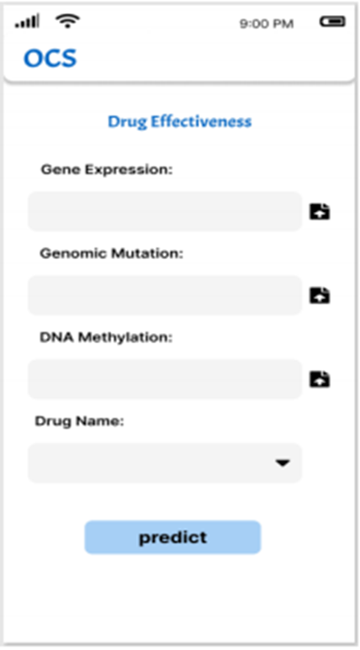
PROBLEM SOLUTION
For doctor:
Machine model

Slide 10
Dataset:
We have integrated three public databases in our study: GDSC and CCLE
In our study, we operate on 256 genes and 238 drugs

Slide 11
GDSC database provide us:
-IC50 values for large-scale drug screening data, of which each IC50 value corresponds to a pair of cancer cell line and drug interaction.
-Half-maximal inhibitory concentration (IC50): is the most widely used and informative measure of a drug's efficacy. It indicates how much drug is needed to inhibit a biological process by half,
- when IC50 value is small, it is evidence that the effectiveness of the drug is high.

Slide 12
CCLE database provide us:
Genomic, transcriptomic and epigenomic data of more than a thousand cancer cell lines. For the three data omics, we focused on gene mutation data, gene expression data, and DNA methylation data.
1. Genomic expression
2.Genomic mutation
3.Genomic methylation

Slide 13
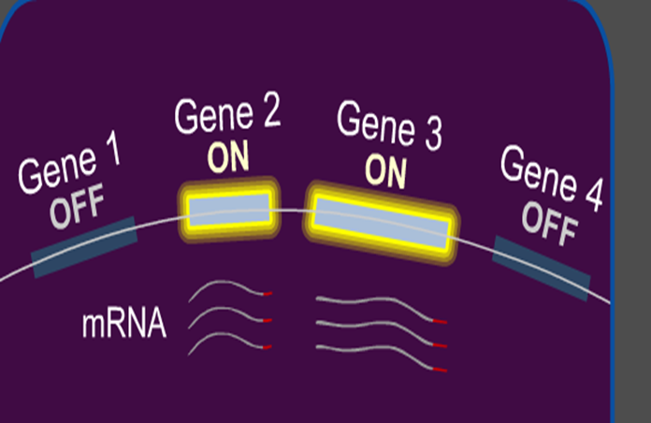
1. Genomic expression
is that process of turning on a specific gene to start making messenger RNA.

Slide 14
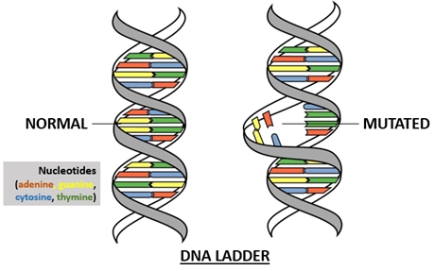
2. Genomic mutation:
are changes to your DNA sequence that happen during cell division.

Slide 15
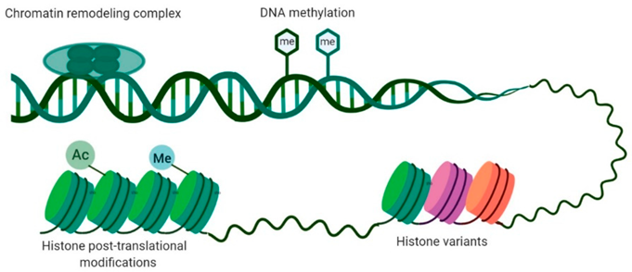
3. Genomic methylation
a biological process by which methyl groups are added to the DNA molecule. - changes in methylation pattern of genes can affect a person’s risk of developing disease such as canser.

Slide 16
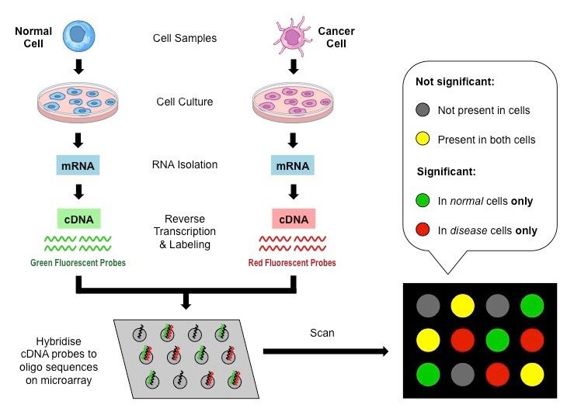
How can get gene expression, mutation, and methylation?
By using microarray: It’s a collection of microscopic DNA spots attached to a solid surface.

Slide 17
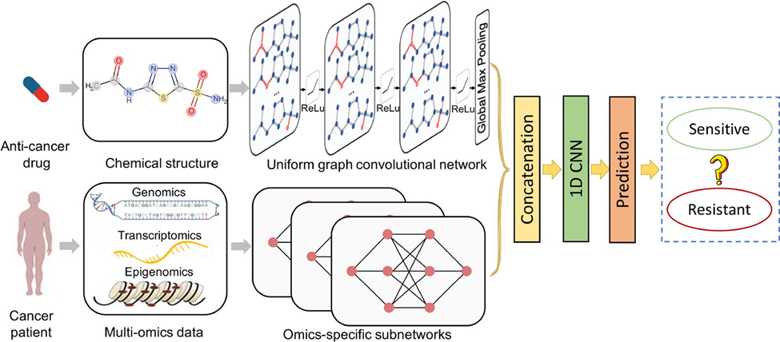
Model
➢ The goal of the model is to determine if the drug is effective for the cancer patient or not depends on cancer cell profiles (genomic mutation, gene expression and DNA methylation data).

Slide 18
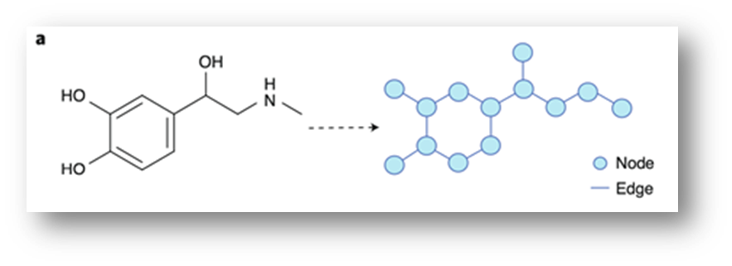
Drug is represented as a graph based on the chemical structure before by the GCN.

Slide 19
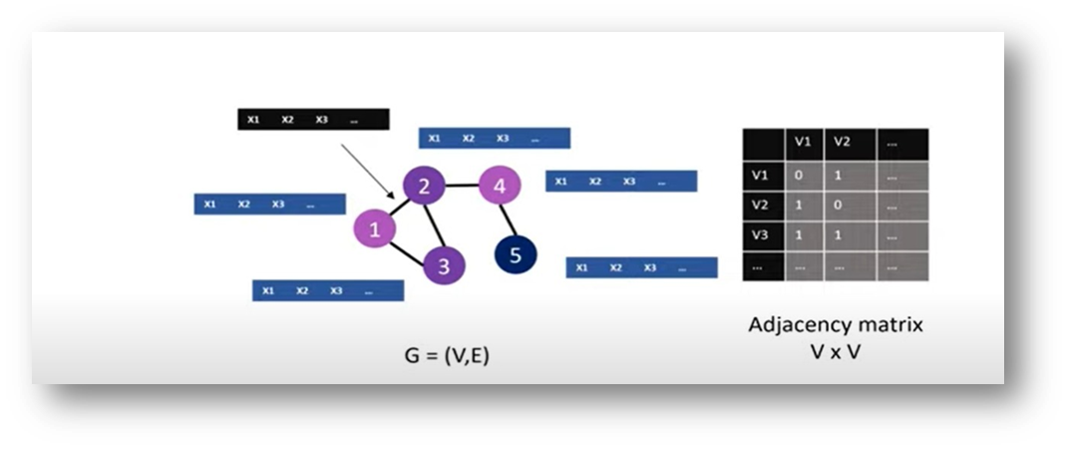
What is GCN?
GCNs are a very powerful neural network architecture for machine learning on graphs.
Graph convolutional network (GCN) is a neural network that operates on graphs. Given a graph
G = (Nodes, Edges).

Slide 20
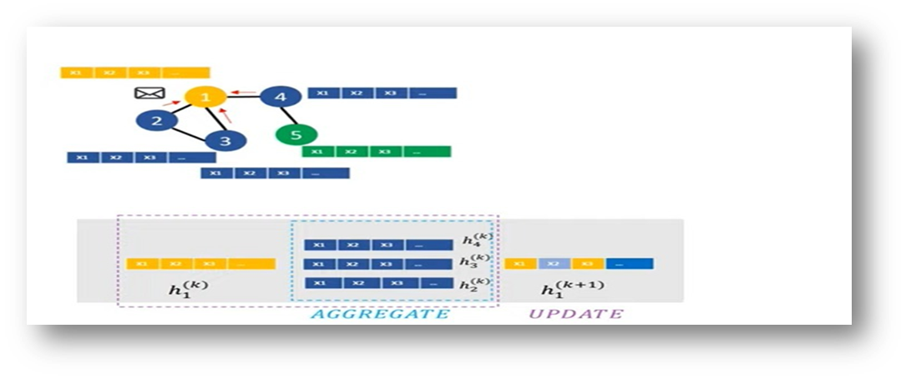
Convolution:
For each node, we get the feature information from all its neighbors.
Each node takes messages from other nodes in more than round.

Slide 21
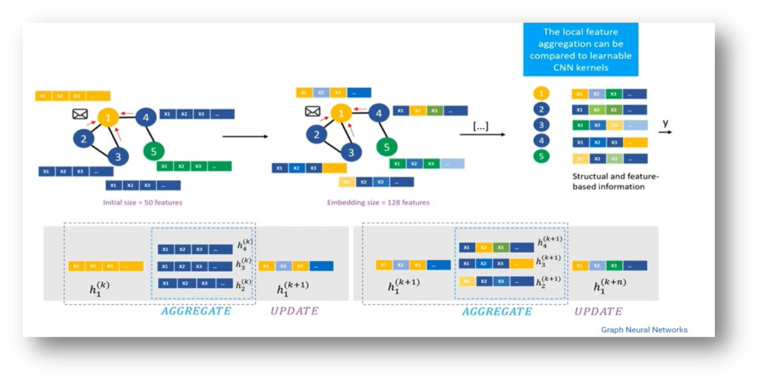

Slide 22
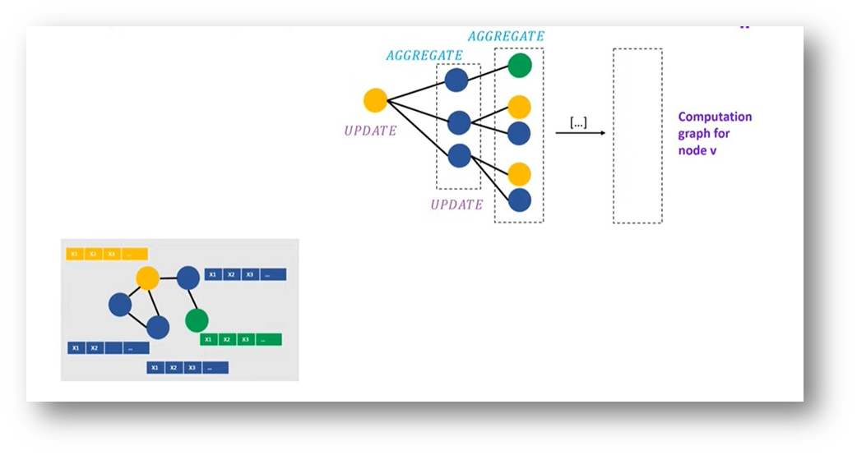
Graph Representation

Slide 23
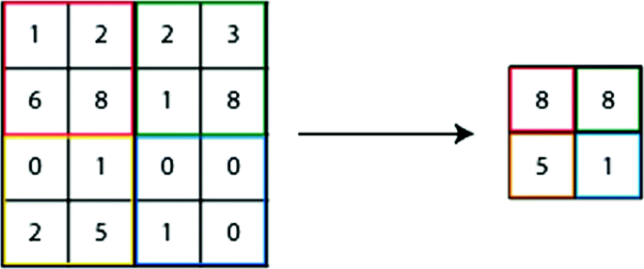
Max Pooling

Slide 24
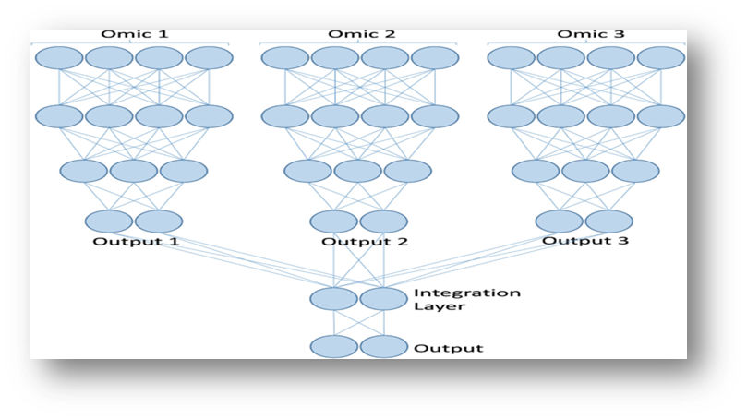
Each Omics data is represented by subnetwork and then integrated to one network.

Slide 25
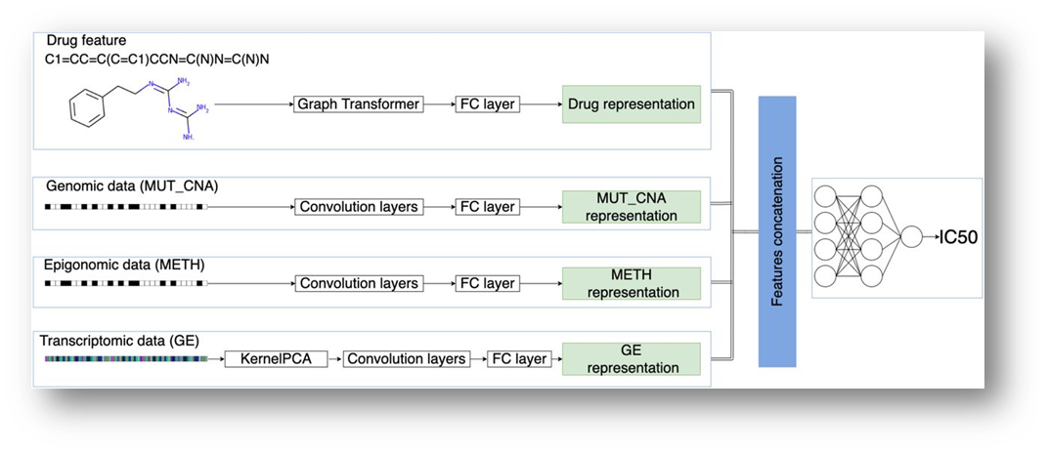
concatenate the network (multi-omics-data) and graph (drug), and fed to CNN.
Finally predicts the drug sensitivity (IC50) (regression), or classifies the drug to be sensitive or resistant (classification).

Slide 26
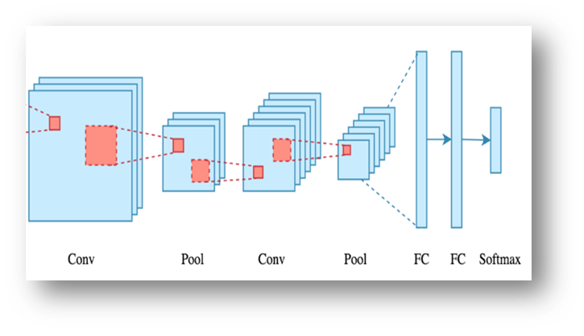
What is CNN? How it works?
A convolutional neural network (CNN) is a class of deep neural network most commonly applied to analyze visual imagery.

Slide 27
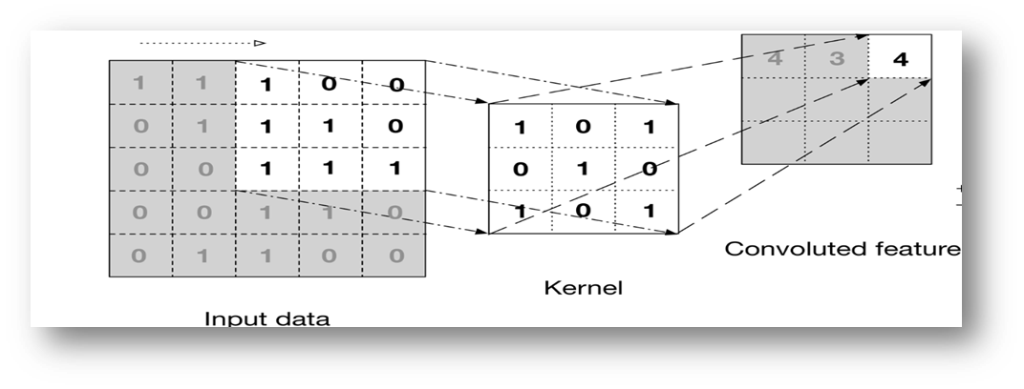
Convolution layer: convolutional neural network apply filter (kernel) to an input to create a feature map that summarize the presence of detected features in the input.
Filter: is a window that scans the image and enable CNNs to learn features from neighboring cells, and take their value by training.

Slide 28
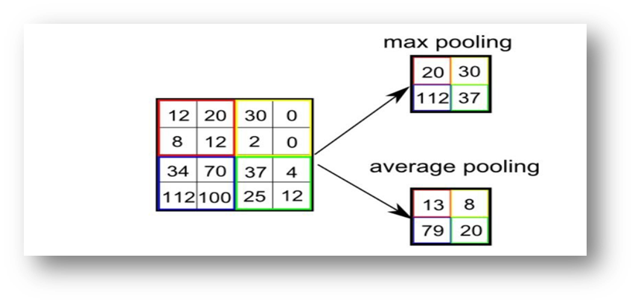
Pooling layer is responsible for reducing the spatial size of the Convoluted Feature. This is to decrease the computational power required to process the data by reducing the dimensions.
There are two types of pooling average pooling and max pooling

Slide 29
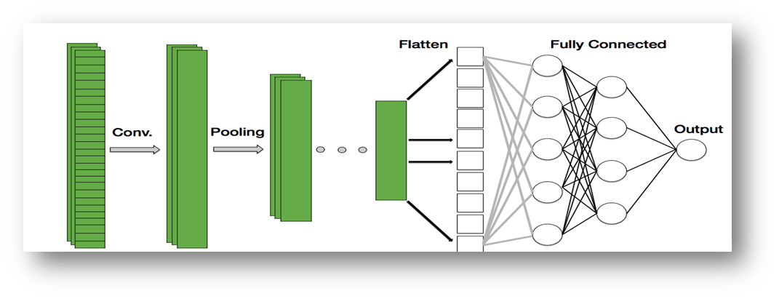
FCI Layer:The feature outputs will be flatten to column vector and feed-forward it to FCL, then this vector will be inputs for neural network.

Slide 30
Results
First:
In the preprocessing step we applied many types of scaling
The best (normalization 0,1)
Second:
we used
train_test_split to split the data
K-fold

Slide 31
Third:
we used
-KNN with GCN
- decision tree with GCN
- random forest with GCN

Slide 32
Result
Changes | IDE | Run Time | Classification Accuracy | Pearson’s correlation
Without Changes | Colab Pro | regression: 25m, classification: 20m | 84.1 | 92.7
Random forest with GCN | Colab Pro | regression: 15m, classification: 12m | 84.29 | 92.91
Decision tree with GCN | Colab Pro | regression: 16m, classification: 14m | 85.24 | 93.33
KNN (K=4) with GCN | Colab Pro | regression :14m, classification:9m | 86.04 | 94.54
k-fold | Colab Pro | regression: 30m, classification: 22m | 87.66 | 95.17

Slide 33
Any Questions?

Slide 34
Thank You!

